Slide 1
Analysis on Kaggle titanic dataset
Hemalatha Subbiah

Slide 2

Introduction
One of the most regarded shipwrecks in history was the sinking of the RMS Titanic.
On April 15, 1912, during her maiden voyage, the widely considered “unsinkable” RMS Titanic sank after colliding with an iceberg. Unfortunately, there weren’t enough lifeboats for everyone on board, resulting in the death of 1502 out of 2224 passengers and crew.
While there was some element of luck involved in surviving, it seems some groups of people were more likely to survive than others.
In this challenge, trying to build a predictive model that answers the question: “what sorts of people were more likely to survive?” using passenger data (ie name, age, gender, socio-economic class, etc).

Slide 3
Variables
Passenger Id is the integer ID of the passenger
Survived is an integer code for the outcome of Survival
Pclass is passenger class serial order; 1 for First class 2 for Second class 3 for Third class
Sex of the passenger
Age of the passenger
SibSp is number of siblings
Parch is number of Parents/Children Aboard
fare - Passenger Fare
cabin - Cabin

Slide 4
Features in Titanic DataSet
Which features are categorical?
Survived, Sex, and Embarked. Ordinal: Pclass.
Which features are numerical?
Continuous and numerical : Age, Fare. Discrete: SibSp, Parch.
DataSet Description :
The training set should be used to build your machine learning models.
The test set should be used to see how well your model performs on unseen data. For the test set, we do not provide the ground truth for each passenger. It is your job to predict these outcomes.

Slide 5
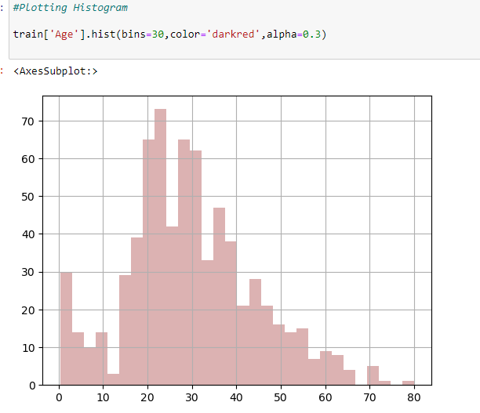
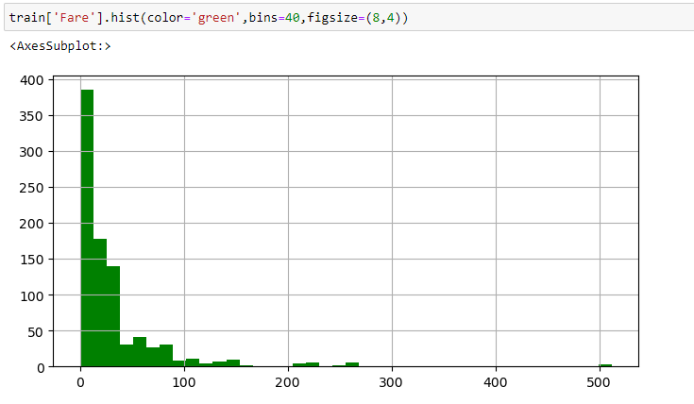
Histogram For Variables
From the histogram above, the histogram appears to be distributed to both left and right indicates the presence of outliers.
From the histogram above, the histogram appears to be distributed to the left, indicates the presence of outliers.

Slide 6
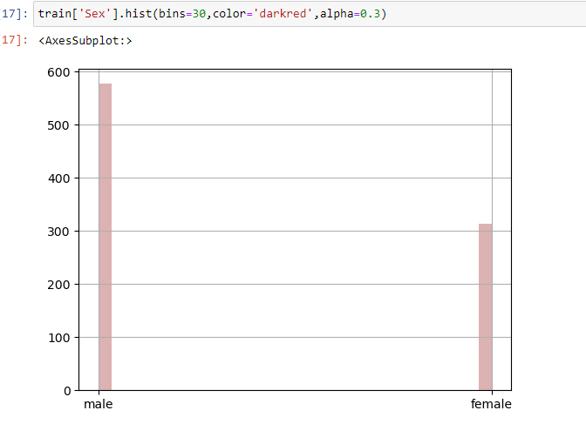
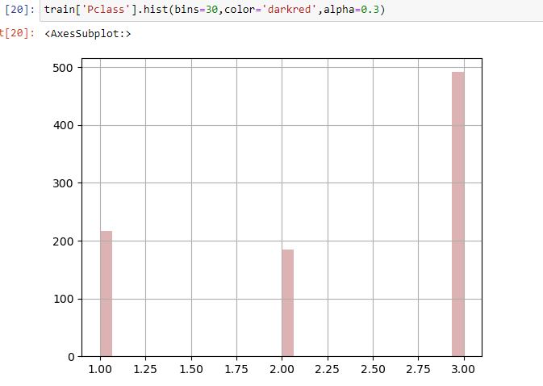
Histogram For Variables

Slide 7
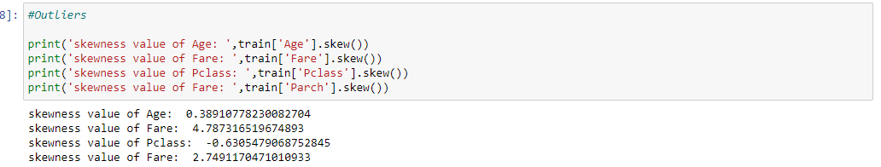
Outliers
The skewness value should be within the range of -1 to 1 for a normal distribution, any major changes from this value indicates the presence of extreme value or outlier. the skewness value should be within the range of -1 to 1 for a normal distribution, any major changes from this value indicates the presence of extreme value or outlier.
From the Histogram

Slide 8
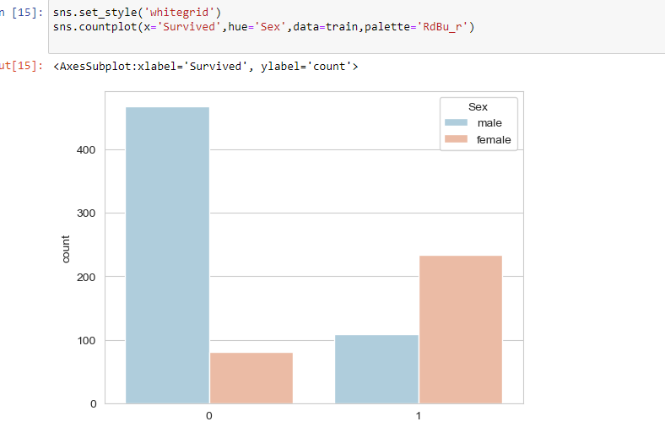
Compare Two scenarios in Titanic DataSet
Based on the Survival column plotting the counter plot ,trying to derive the number of people survived based on sex.

Slide 9
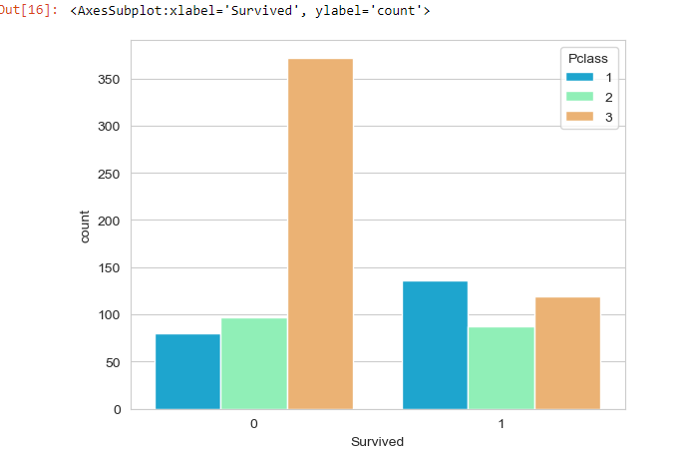
Compare Two scenarios in Titanic DataSet
Based on the Survival column plotted the counter plot ,trying to derive the number of people survived based on Passenger Class. Looks like more than 350 people not survived
in pclass ‘3’ and around 100-150 people survived in pclass ‘3’.

Slide 10
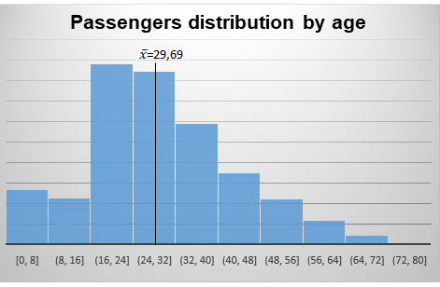
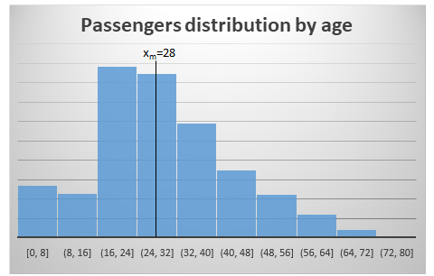
Mean, Median, Spread and Tails
Mean is average value of a dataset. considering Age variable the visualization is shown below:
Median represents the middle value. Considering Age the distribution is visualized as below:
The Titanic and the Age of its passengers display a certain positive asymmetry (Mean = 29.69 > Median = 28 > Mode = 24) which indicates that there were more people below 29.69 years.
The variance of this dataset considering Age in the sample train.csv is 21,101 and the
standard deviation of the sample with Age variable is 1452 years with a sample error of 0.54.

Slide 11
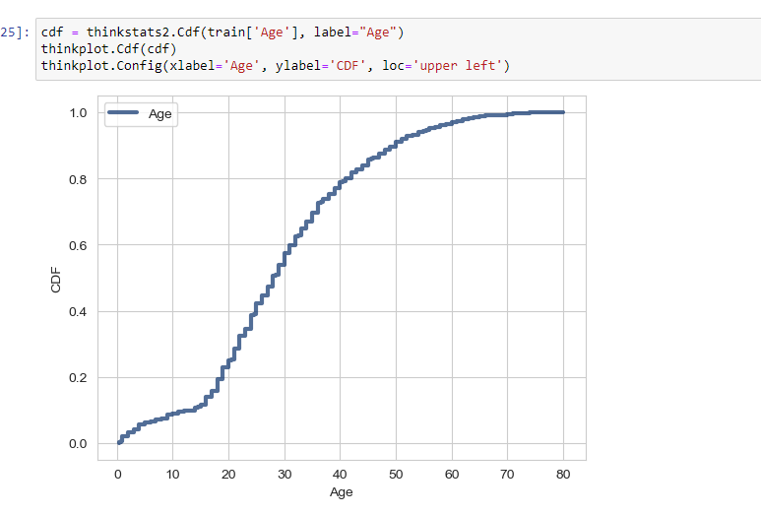
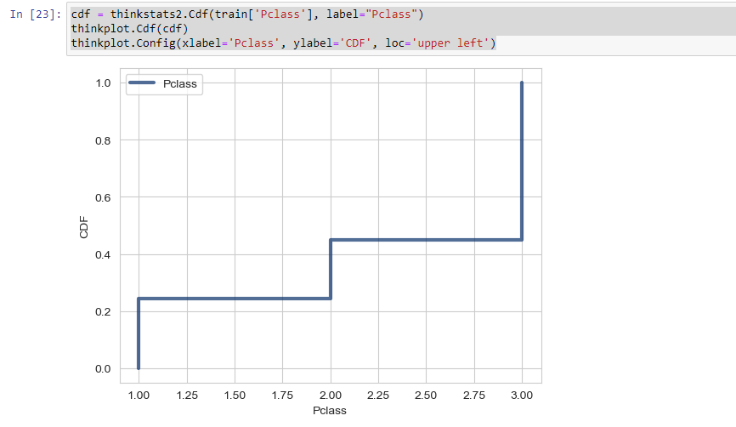
CDF of Titanic DataSet

Slide 12
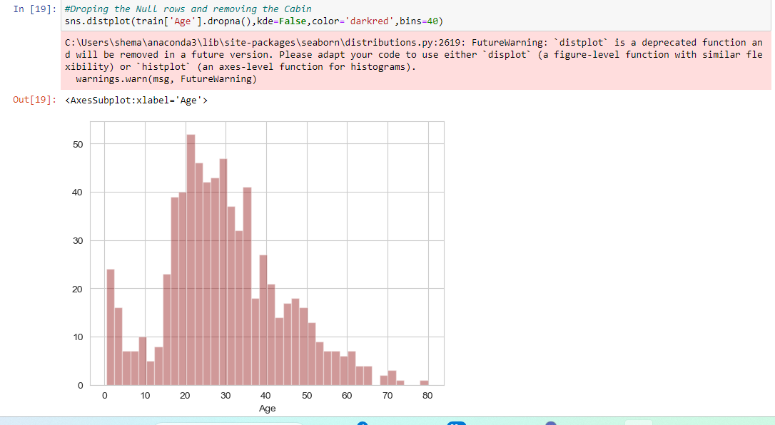
Distribution of Titanic DataSet
Distribution of age followed Normal distribution plotted using Histogram and dropped ‘NA’ values and the count of people in the range 5-10 is 110 and average lies between age 20-40.Distribution comes out as an Bell Shaped curve with outliers with bin=40.

Slide 13
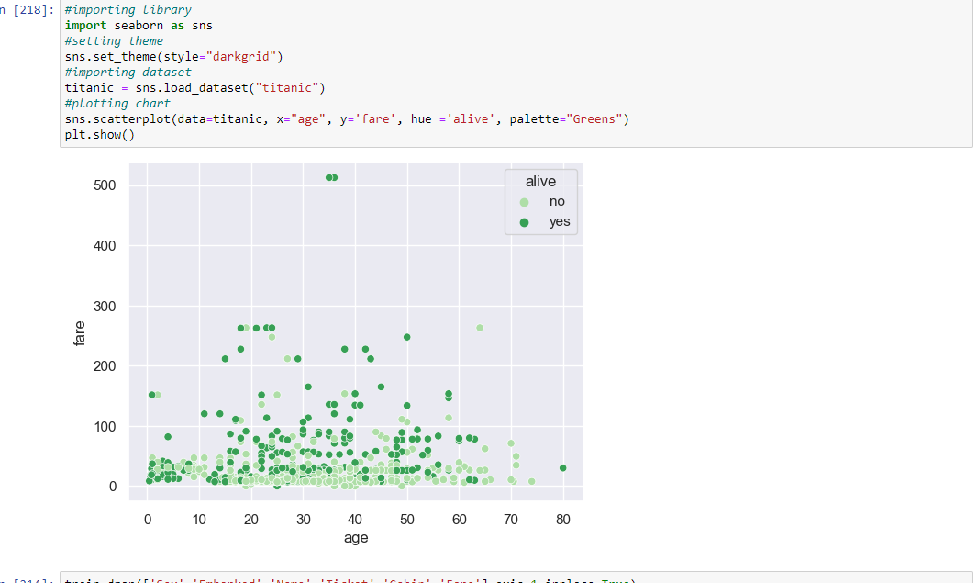
Scatter Plot for 2 Variables
Distribution of age followed Normal distribution plotted using Histogram and dropped ‘NA’ values and the count of people in the range 5-10 is 110 and average lies between age 20-40.Distribution comes out as an Bell Shaped curve with outliers with bin=40.

Slide 14
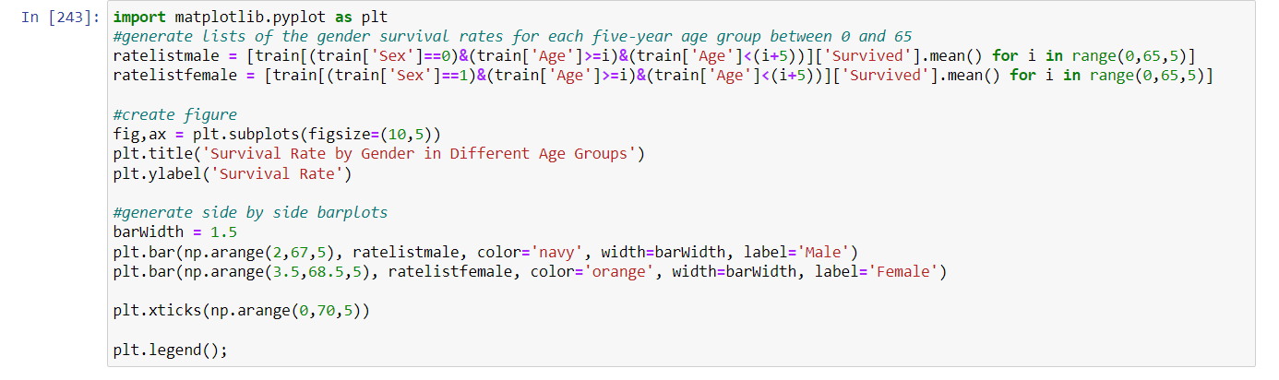
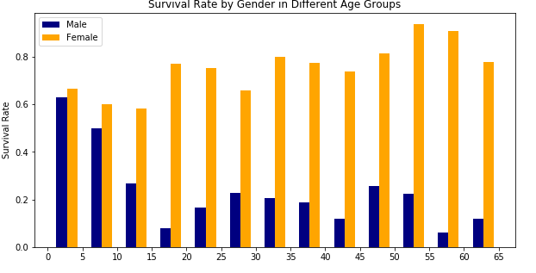
Survival Rate by Sex in Different Age Groups
Female survival seems to increase with age, while male survival drops off past a certain age. In particular, this plot visualizes that children under the age of 5 or even under the age of 10 are treated mostly the same in terms of lifeboat allotments or priority, but from age 12 or so on an enormous gap opens between the genders, indicating that males of age were expected to yield lifeboat seats to women and children.

Slide 15
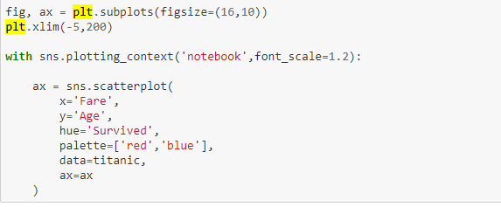
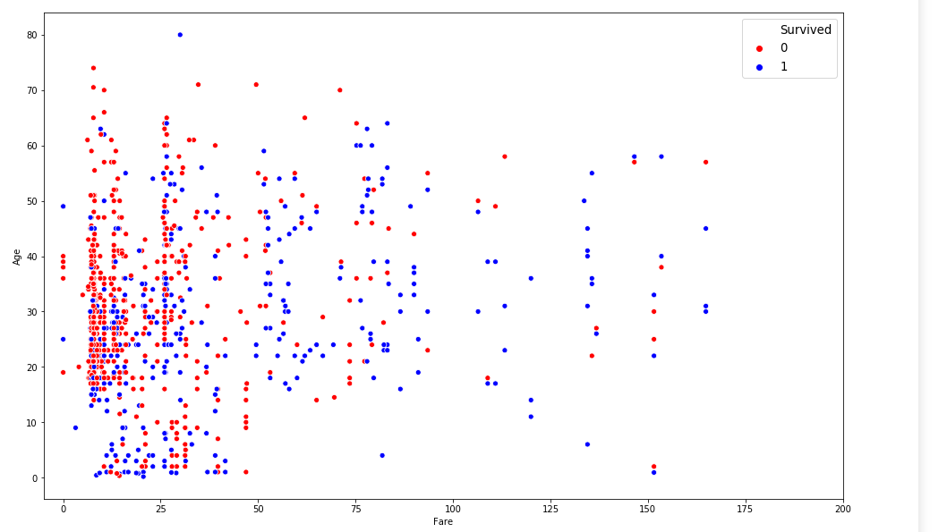
Survival by Age and Fare
Fares over 200 have not been included, for scaling reasons. Red indicates that the passenger perished, while Blue indicates survival. We can see very clearly that the great density of deaths occurred among lower tier pricing passengers between the ages of 17 and 45. We can see that there is a trend toward survival as fares increase, and also as age decreases.

Slide 16
Survival by Age and Fare
Fares over 200 have not been included, for scaling reasons. Red indicates that the passenger perished, while Blue indicates survival. We can see very clearly that the great density of deaths occurred among lower tier pricing passengers between the ages of 17 and 45. We can see that there is a trend toward survival as fares increase, and also as age decreases.

Slide 17
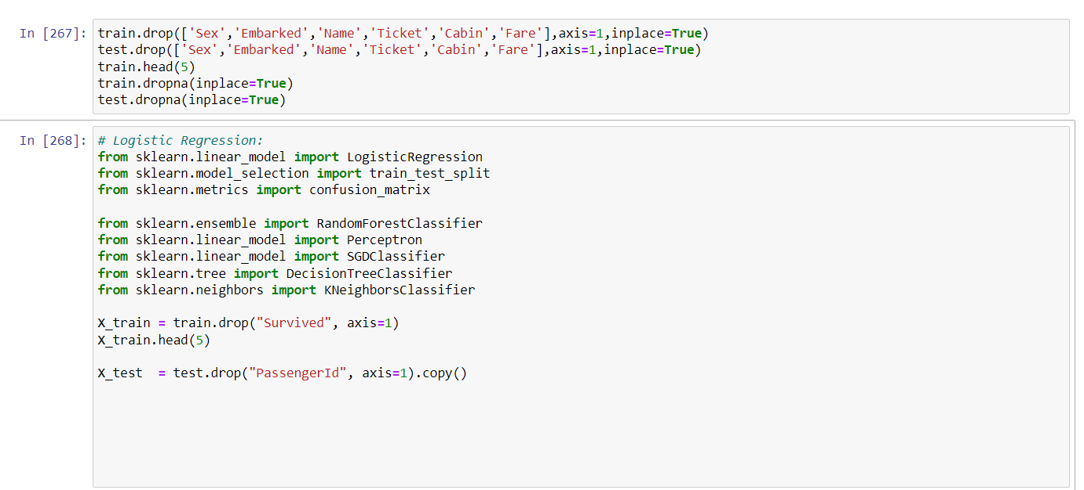
Survival by Age and Fare
logmodel = LogisticRegression()
logmodel.fit(X_train,Y_train)
predictions = logmodel.predict()
accuracy=logmodel.score(X_train, Y_train)
acc_sgd = round(logmodel.score(X_train, Y_train) * 100, 2)
accuracy
output = 0.72311235955056

Slide 18
Hypothesis Testing
Null Hypothesis: There is no significant difference in Age distribution between those who survived and those who did not for male.
Alternative Hypothesis: There is significant difference in Age distribution between those who survived and those who did not for male.
Results:
## Method P.Value
## 1 Two-sample Kolmogorov-Smirnov test 0.013259850
## 2 Wilcoxon rank sum test with continuity correction 0.005118923
The P-Value of both the two-sample KS test and Wilcoxon rank sum test were found to be less than 0.05.
There is a strong evidence against the Null Hypothesis.
There is significant difference in Age distribution between those who survived and those who did not for Female.

Slide 19
Model Prediction
Fares over 200 have not been included, for scaling reasons. Red indicates that the passenger perished, while Blue indicates survival. We can see very clearly that the great density of deaths occurred among lower tier pricing passengers between the ages of 17 and 45. We can see that there is a trend toward survival as fares increase, and also as age decreases.

Slide 20
Summary
I started with the data exploration where I got a feeling for the dataset, checked about missing data and learned which features are important. During this process I used seaborn and matplotlib to do the visualizations. During the data preprocessing part, computed missing values, converted features into numeric ones, grouped values into categories and created a few new features. Afterwards started training machine learning models, values. Lastly, looked at it’s confusion matrix and computed the models precision .

Slide 21




Thank you
Hemalatha Subbiah

